Slide 1
Sensor Network using CAN & IoT
Centre for Development of Advanced Computing (C-DAC), ACTS
(Pune- 411008)
PG-Diploma in Embedded Systems and Design (PG-DESD)
C-DAC, ACTS (Pune)
Guided By: Mr Shripad Deshpande
Submitted By:
240340130014 Hemant Dethe
240340130026 Krushna Dhavne
240340130038 Sarthak Choudhari
240340130039 Saurabh Chikhlonde

Slide 2
Introduction
This project presents the development of a CAN-based sensor network specifically designed for industrial monitoring applications
Utilizes the Controller Area Network (CAN) protocol, which is known for its reliable and real-time communication capabilities
Incorporates a variety of sensors to efficiently monitor environmental and security parameters within industrial settings
Enhances the network with IoT technologies to facilitate seamless data transmission.
Provides a robust and secure solution for real-time monitoring in industrial environments
Offers a scalable and cost-effective solution for industrial application, improving operating efficiency and safety through flexible, real-time environmental and security monitoring

Slide 3
Problem Statement
Operational Efficiency & Safety: Industrial environments require constant monitoring to ensure efficiency and safety, but traditional systems often fall short in scalability and real-time data provision.
Cost & Scalability Issues: Existing systems are costly and inflexible, making them unsuitable for small-scale factories and large enterprises that need to monitor diverse areas.
Communication Challenges: Traditional systems lack an integrated, robust communication protocol, leading to inefficiencies and increased risk.
Data Integration: Traditional systems struggle with integrating data from multiple sources. This project aims to create a CAN-based sensor network that offers seamless data integration and advanced analytics
Project Goal: The project aims to develop a CAN-based sensor network that offers a scalable, cost-effective, and reliable solution for real-time industrial monitoring.

Slide 4
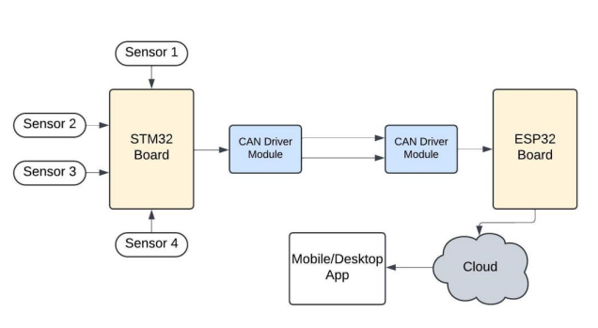
Block Diagram

Slide 5
Block Diagram
STM32 Board: Central hub collecting data from multiple sensors.
Sensors: Real-time data acquisition from various environmental or system parameters.
CAN Driver Modules: Ensures reliable communication between STM32 and ESP32 boards.
ESP32 Board: Handles wireless communication and data processing.
Cloud Integration: Enables data storage and remote access.
Mobile/Desktop App: Provides user interface for monitoring and control.

Slide 6
Software and Components Used
Hardware
Softwares
STM32F4 Discovery Board
ESP32 Wroom-32
BMP180 sensor
GAS Sensor
PIR Motion Sensor
Heat Flame Sensor.
TJA1050 CAN Controller.
MCP2551 CAN-BUS TRANSCEIVER.
PCB Board.
Rainbow and Jumper Wires.
STM32FCubeIDE
Arduino IDE
Cloud Platform (ThingsSpeak)

Slide 7
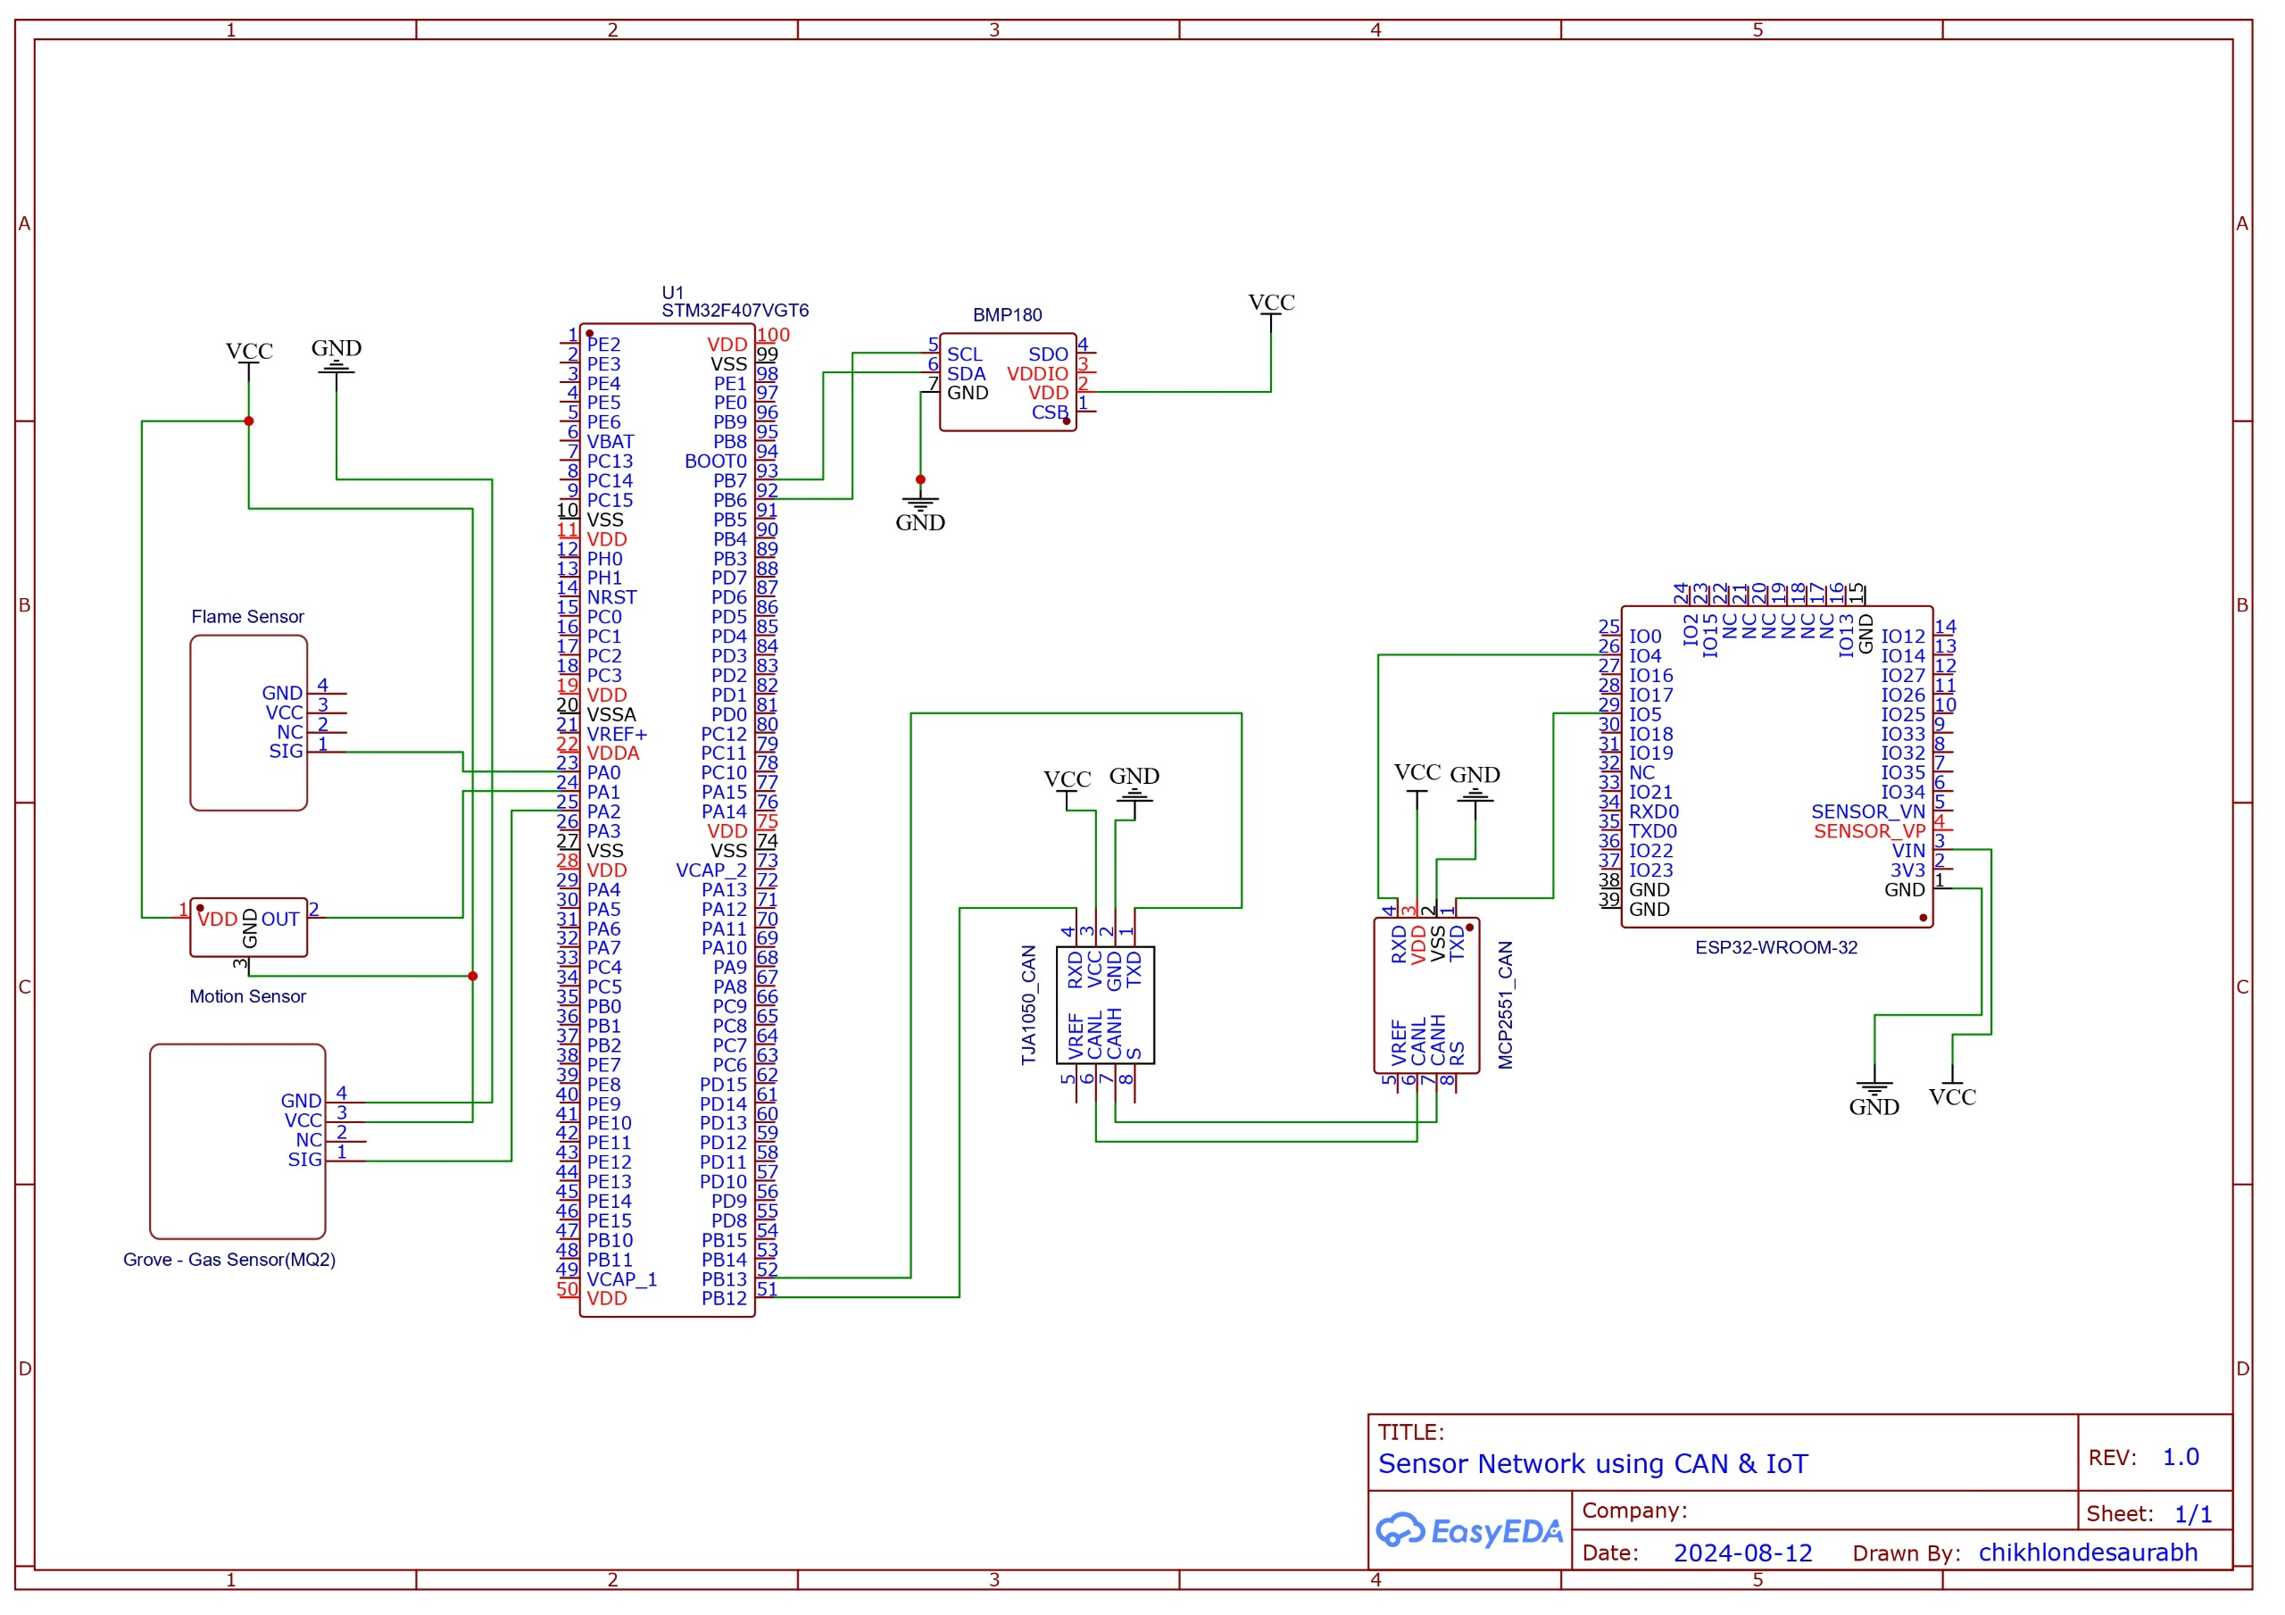
Circuit Diagram

Slide 8
Working
The working of the project involves a system where various sensors collect environmental data, which is then processed by an STM32 microcontroller. This processed data is transmitted to an ESP32 board using the CAN Bus protocol. The ESP32 board, equipped with Wi-Fi, sends the data to a cloud platform for storage and analysis. Users can access and monitor this data in real-time through a mobile or desktop app, allowing for remote control and management of the system. This seamless integration of hardware and software ensures efficient data collection, communication, and remote accessibility.
Data Collection: The system uses various sensors (BMP180 for temperature/pressure, gas sensor, PIR motion sensor, and heat flame sensor) to gather environmental data. These sensors are connected to the STM32F407VGT6 microcontroller, which processes the raw data, preparing it for transmission.
Communication via CAN Bus: The STM32 board communicates with the ESP32 board using the CAN Bus protocol, facilitated by the TJA1050 CAN Controller and MCP2551 CAN-BUS Transceiver. This ensures that the data is transmitted efficiently and reliably between the two boards.

Slide 9
Wireless Data Transmission: The ESP32 Wroom-32 board, equipped with Wi-Fi capabilities, receives the processed data from the STM32 board. It then wirelessly transmits this data to a cloud platform, enabling remote access and real-time monitoring
Cloud Integration and Storage: Once the data reaches ThingsSpeak, it is stored, processed, and made accessible for remote monitoring. This allows for the visualization of real-time data and the configuration of alerts or automated actions based on specific thresholds.
Remote Monitoring and Control: Users can access the data through a mobile or desktop app, which provides a user-friendly interface for monitoring the sensor data in real-time. The app also allows users to adjust settings, receive alerts, and manage the system remotely, ensuring quick responses to any critical changes in the environment.
In essence, working defines the system's sequentially execution, describing how it achieves its objective by effectively coordinating hardware and software components.

Slide 10
Advantages
Real-Time Monitoring - Provides instant insights and alerts.
Remote Accessibility - Accessible via mobile or desktop apps for off-site monitoring.
Reliable Communication - Robust CAN Bus ensures error-free data transfer.
Cloud Integration - Scalable storage and advanced analytics.
Flexibility - Easily expandable with additional sensors or IoT platforms.
Early Warning System - Quick response to critical environmental changes.
Cost-Effective - Utilizes affordable, widely available components.
User-Friendly - Intuitive interface for easy control and monitoring.

Slide 11
Limitation
Dependency on Internet: Remote accessibility and cloud integration rely on a stable internet connection, which could be a limitation in areas with poor connectivity.
Power Consumption: Continuous real-time monitoring and wireless communication may lead to higher power consumption, requiring efficient power management strategies.
Security Concerns: Storing data in the cloud and enabling remote access could expose the system to security vulnerabilities, requiring robust encryption and authentication methods.
Maintenance Requirements: Regular updates and maintenance may be needed to keep the system functioning optimally and to address any software or hardware issues.
Cost Over Time: While the project is initially cost-effective, ongoing costs such as cloud storage fees, internet access, and maintenance could add up over time.

Slide 12
Application
Environmental Monitoring:Environmental monitoring involves tracking and analyzing environmental conditions, like temperature , gas levels, and flames , to ensure safety and detect potential risks.
Industrial Safety: Delivers real-time alerts for hazardous conditions such as gas leaks and fires, helping to prevent accidents.
Predictive Maintenance: Analyzes sensor data to forecast equipment failures, reducing downtime and cutting maintenance costs.
Remote Monitoring: Facilitates remote access to sensor data, enhancing management and decision-making capabilities.
Scalability: Easily integrates and adapts to various industrial environments, from small-scale operations to large enterprises. define it in presentable way.

Slide 13
Future Scope
IoT Ecosystem Expansion: Growth of interconnected devices will enhance data-driven decision-making and operational efficiency within your CAN network and STM32-based system.
AI & Machine Learning Integration: Advanced algorithms will enable predictive maintenance, real-time anomaly detection, and optimized system performance.
Improved Connectivity: Emerging technologies like 5G and LPWAN will ensure reliable, real-time data transmission, even in remote or challenging environments.
Enhanced Data Security: Focus on advanced encryption and authentication to protect data across the network.
Energy Efficiency & Sustainability: Development of low-power, long-lasting devices will support sustainable practices and extended deployment in remote areas.

Slide 14
Conclusion
Enables continuous data collection and immediate insights for proactive decision-making
Utilizes CAN communication and wireless technologies like ESP32 for efficient remote data transmission
Adapts easily to various industrial settings and integrates seamlessly with existing systems
Provides real-time alerts to detect and respond to anomalies and hazardous conditions
Optimizes processes by leveraging real-time data to improve overall system performance and safety

Slide 15
Thank You

